Slide 1

Comparative Analysis of Hotel Reviews: An example Case Study
Ali El Masri
Notes:
"Welcome to this presentation on the Comparative Analysis of Hotel Reviews. It is important to note that this is a hypothetical scenario and the data used in this study are very old and selective, not by any mean a representation of the current reality. I am Ali El Masri and today I will walk you through our study, methodologies, findings, and recommendations."

Slide 2
Abstract
Detailed analysis of hotel reviews
Focus on New York Marriott Marquis and competitors
Aim: Derive actionable insights to enhance customer satisfaction
Notes:
"This study offers a detailed comparative analysis of hotel reviews for the New York Marriott Marquis and its top five competitors in New York City. Our goal is to derive actionable insights that can ultimately enhance customer satisfaction and maintain a competitive edge."

Slide 3
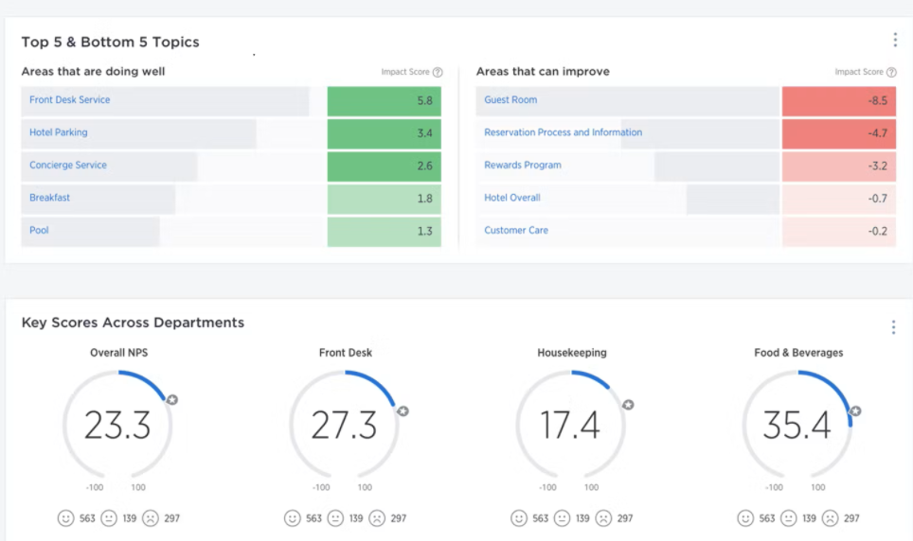
Introduction
Typical third-party review metrics dashboard
Gap in deeper insights from these metrics
Analysis using NLP techniques
Aim: Uncover trends for better business decisions
Notes:
"Third-party booking sites often lack deeper insights into guest reviews. Here is an example of a typical dashboard from third-party booking sites displaying review metrics. While these dashboards provide some useful information, they often lack deeper insights into guest reviews. Our goal is to bridge that gap by analyzing guest reviews of the New York Marriott Marquis and its competitors, using advanced Natural Language Processing techniques. This analysis aims to inform better business decisions and strategies for improving our guest experiences."

Slide 4

Methodology
Data collection, cleaning, preprocessing
Topic modeling and sentiment analysis
Tools: BERTopic, DistilBERT
Notes:
"Our methodology encompasses several steps, including data collection, cleaning, preprocessing, topic modeling, and sentiment analysis. I employed BERTopic for topic modeling and DistilBERT for sentiment analysis to ensure state-of-the-art capabilities in extracting and analyzing textual data."

Slide 5

Data Collection
878,561 Tripadvisor reviews from 4,333 hotels
Filtered to 200,000 English reviews
Focused on 10,000 reviews for
New York Marriott Marquis and competitors
Notes:
“The dataset, was sourced from TripAdvisor. After refining it, I focused on approximately 200,000 English reviews and narrowed it further to around 10,000 reviews specific to the New York Marriott Marquis and its main five competitors."

Slide 6

Data Cleaning and Preprocessing
Language Detection using langdetect
Topic Modeling: SentenceTransformer,
UMAP, HDBSCAN
Vectorization
Notes:
"Our data cleaning and preprocessing steps included language detection using the langdetect library, followed by topic modeling using tools like SentenceTransformer, UMAP for dimensionality reduction, and HDBSCAN for density clustering. I also used vectorization techniques to ensure the text data was ready for analysis."

Slide 7
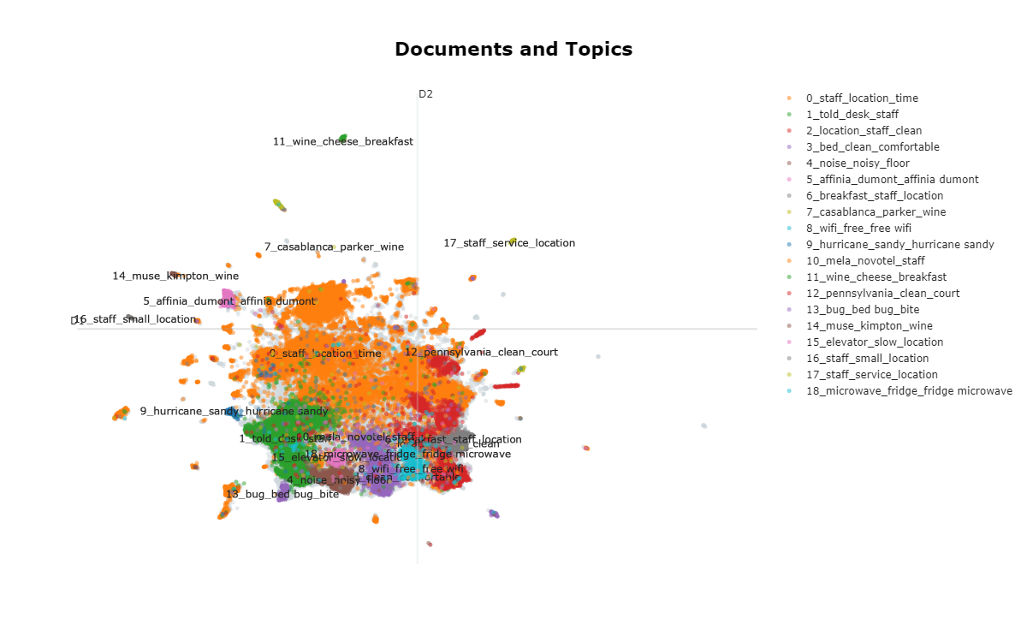
Topic Modeling Results
Scatter plot of documents and topics
Intertopic distance map
Topics per class
Hierarchical clustering
Notes:
“By topic modeling the dataset, I was able to visualize the prevalent topics discussed by guests. I created a scatter plot showing the distribution of documents across different topics, an intertopic distance map, a bar chart of topics per class, and a hierarchical clustering dendrogram."

Slide 8
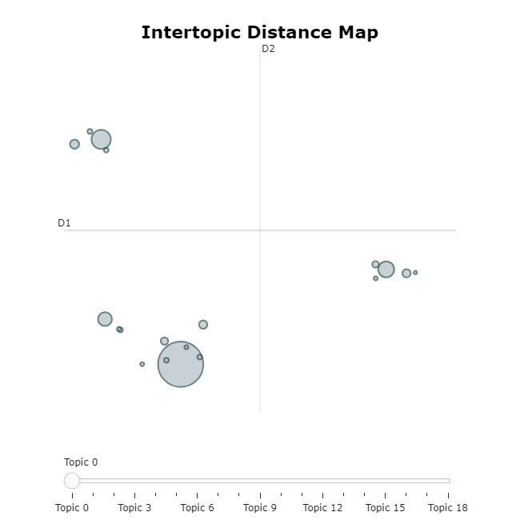
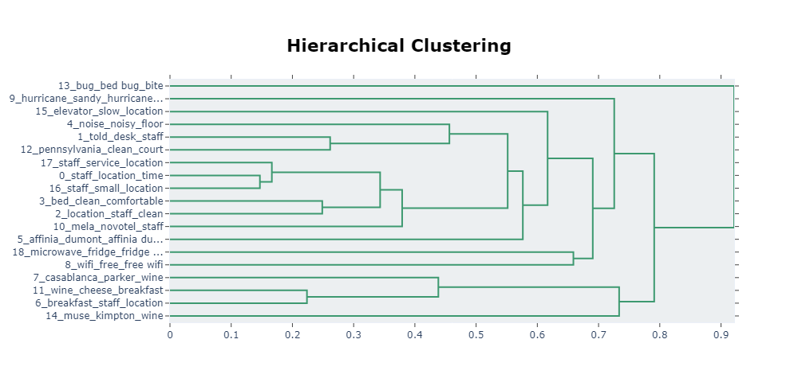
Topic Modeling Results
Notes:
"Let's look at the topic modeling results. On the left, we have the Intertopic Distance Map. This map is interactive and visualizes the distances between different topics identified in the guest reviews. Each circle represents a topic, and the size of the circle indicates the prevalence of that topic. Topics that are closer together are more similar, while those farther apart are more distinct. This visualization helps us understand the diversity and concentration of discussions in the reviews.
Obviously we’re not able to interact with this graph here, but we’re able to do so in jupyter notebook.
On the right, we see the Hierarchical Clustering dendrogram. This chart illustrates the hierarchical relationships between topics, with each branch representing a different topic. The length of the branches indicates the distance or dissimilarity between topics. This clustering helps us visualize the nested structure of topics, revealing how they group together at various levels. By analyzing these clusters, we can gain deeper insights into how different themes are related and how they contribute to the overall guest experience."

Slide 9
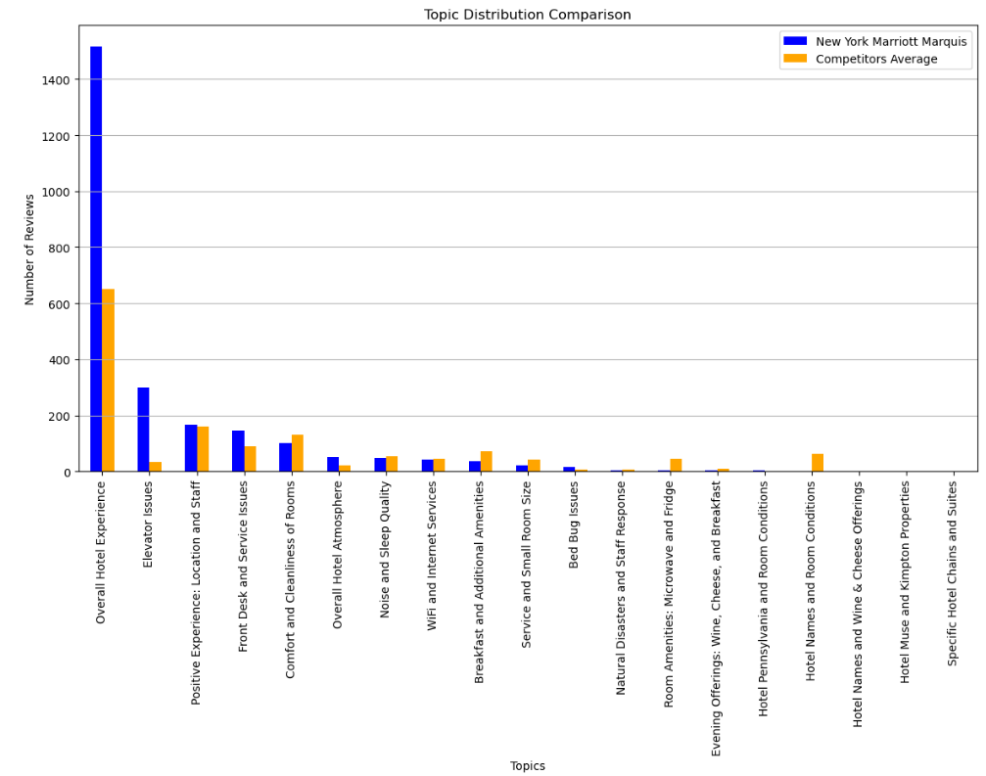
Topic Distribution Analysis
Topic distribution in reviews
Comparison between New York
Marriott Marquis and competitors
Notes:
“On this slide, we can see that I mapped these topics into a more reliable and more informative format, and therefore analyzed the distribution of the topics discussed for the New York Marriott Marquis and compared it to that of its competitors. This helps us identify which topics are more prominent in guest reviews across properties.."

Slide 10
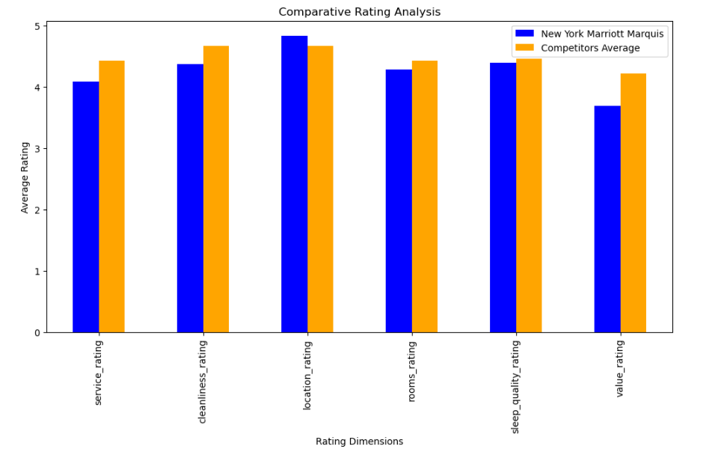
Comparative Rating Analysis
Average ratings comparison
Dimensions: service, cleanliness, location,
rooms, sleep quality, value
Notes:
“Here, we see your typical hotel metric which compares the average ratings for different dimensions such as service, cleanliness, location, rooms, sleep quality, and value between different hotels, this graph illustrate the comparison for the New York Marriott Marquis and its competitors. We can refine this analysis by incorporating sentiment analysis on the reviews.

Slide 11
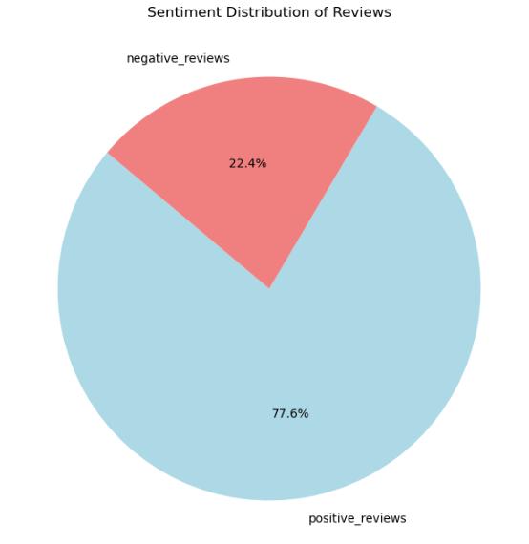
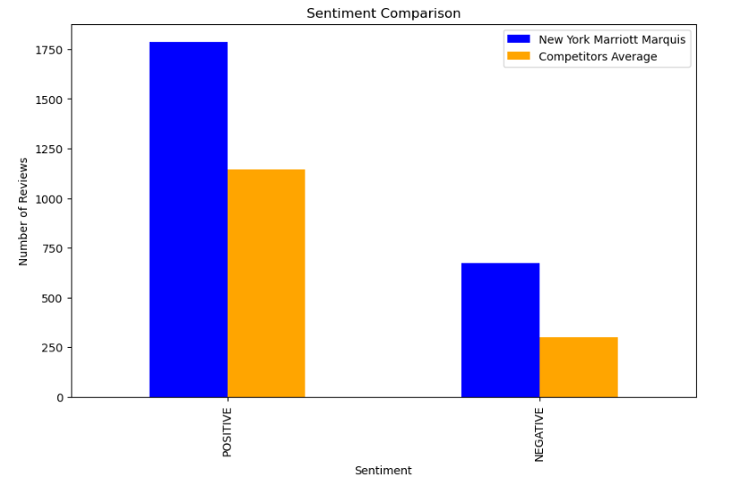
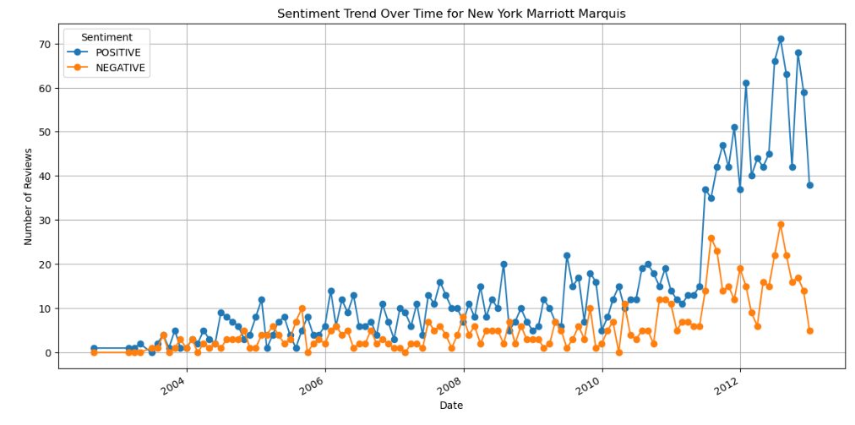
Sentiment Comparison
Distilbert-base-uncased-finetuned-sst-2-english
Sentiment distribution: positive vs. negative
Comparison between New York Marriott Marquis and competitors
Trends in Sentiment and Overall ratings over time
Notes:
"For sentiment analysis, i used the distilbert-base-uncased-finetuned-sst-2-english model. This model identifies the overall sentiment trends."
“I compared the sentiment distribution, both positive and negative, for the New York Marriott Marquis with that of its competitors. This comparison helps us understand the overall guest sentiment towards each hotel.“
“I performed a time series analysis to compare the trends in sentiment and overall ratings over time for the New York Marriott Marquis and its competitors, to identify periods of change in guest satisfaction."

Slide 12

S.W.O.T Discussion
Strengths: Location, positive sentiment trends
Weaknesses: Low-scoring areas, negative sentiment trends
Opportunities: Customer feedback loop, new services
Threats: Competitor performance,
Notes:
"This entire process allows us to conduct a data-backed S.W.O.T analysis. By leveraging data science techniques, we are able to derive actionable insights that are supported by the data. We can clearly identify the strengths such as location and positive sentiment trends

Slide 13

Conclusion
Detailed comparative analysis
Recommendations for improvement
Future work: demographic analysis, larger dataset
Notes:
"In conclusion, our study provides a detailed comparative analysis of hotel reviews for the New York Marriott Marquis and its competitors. The insights derived can help improve customer satisfaction and maintain a competitive edge. Future work can focus on incorporating demographic analysis and expanding the scope of analysis to include more competitors and a larger dataset."

Slide 14
References
GitHub Link for Visualizations and Analysis Code
Data Source and Models Reference Links :
https://github.com/elmasri-ali
Notes:
"For those interested in further details, my Github link includes supporting documentation, additional visualizations and analysis code. You can also find reference links to the data source and models we used."

